Slide 1


ANNA UNIVERSITY
CHENNAI
GOVERNMENT COLLEGE OF ENGINEERING, ERODE
GOVERNMENT WELFARE ADVISORY SYSTEM
SUBMITTED BY
KARTHI C (731122104024)
SANJAY KUMAR S (731122104044)
SHANMUGA RAJA M (731122104047)
DEPARTMENT OF COMPUTER SCIENCE AND ENGINEERING
PROJECT SUPERVISOR
Mrs. S. VIJAYALAKSHMI M.E.,
ASSISTANT PROFESSOR
DEPARTMENT OF COMPUTER SCIENCE AND ENGINEERING

Slide 2
ANNA UNIVERSITY
CHENNAI
GOVERNMENT COLLEGE OF ENGINEERING, ERODE
INTRODUCTION
The Government Welfare Advisory System is a modern web-based application developed to simplify the process of accessing government welfare schemes and benefits. Governments provide numerous welfare programs for students, farmers, senior citizens, women, unemployed individuals, and economically weaker sections of society.
This project aims to create a centralized digital platform where users can easily discover welfare schemes that match their personal and economic background. By entering details such as age, income, occupation, education, gender, and category, users can receive personalized scheme recommendations. The system also allows users to apply for schemes online, upload required documents, and track the status of their applications.

Slide 3
ANNA UNIVERSITY
CHENNAI
GOVERNMENT COLLEGE OF ENGINEERING, ERODE
PROBLEM STATEMENT
Citizens face difficulty in:
Identifying relevant welfare schemes
Understanding eligibility criteria
Accessing accurate and updated information
Manual searching is:
Time-consuming
Confusing
Error-prone
Lack of a personalized recommendation system for welfare schemes.

Slide 4
ANNA UNIVERSITY
CHENNAI
GOVERNMENT COLLEGE OF ENGINEERING, ERODE
OBJECTIVES
To develop a centralized platform for accessing government welfare schemes.
To recommend suitable schemes based on user eligibility and personal details.
To simplify the application and document submission process.
To provide real-time application status tracking for users.
To improve transparency, accessibility, and efficiency in welfare scheme management.
To reduce manual work and increase awareness among citizens about government benefits.

Slide 5
ANNA UNIVERSITY
CHENNAI
GOVERNMENT COLLEGE OF ENGINEERING, ERODE
EXISTING SYSTEM
Currently, government welfare schemes are managed through separate government portals and offline offices. Citizens search for scheme information through official websites, e-Sevai centers, or government departments. Users must manually check eligibility criteria, fill application forms, submit documents, and visit offices for verification and status updates.
Limitations of Existing System
Information is distributed across multiple websites and departments.
No personalized scheme recommendation system.
Limited awareness among rural and less digitally skilled citizens.
Difficulty in tracking application status and updates efficiently.

Slide 6
ANNA UNIVERSITY
CHENNAI
GOVERNMENT COLLEGE OF ENGINEERING, ERODE
PROPOSED SOLUTION
The proposed Government Welfare Advisory System provides a centralized web-based platform that helps citizens easily identify and access suitable government welfare schemes. The system collects user details such as age, income, education, occupation, and category to recommend eligible schemes automatically.
Users can view scheme details, apply online, upload required documents, and track application status in real time. Administrators can manage schemes, verify applications, and update records efficiently. The system improves transparency, reduces manual work, and simplifies the welfare scheme application process for citizens.

Slide 7
ANNA UNIVERSITY
CHENNAI
GOVERNMENT COLLEGE OF ENGINEERING, ERODE
SYSTEM ARCHITETURE
The Government Welfare Advisory System follows a three-tier architecture consisting of the Frontend, Backend, and Database layers.
Frontend (React.js): Provides the user interface for registration, login, scheme recommendation, application submission, and status tracking.
Backend (Spring Boot): Handles business logic, user authentication, scheme management, application processing, and REST API communication.
Database (MySQL): Stores user details, welfare schemes, applications, uploaded documents, and status information securely.

Slide 8
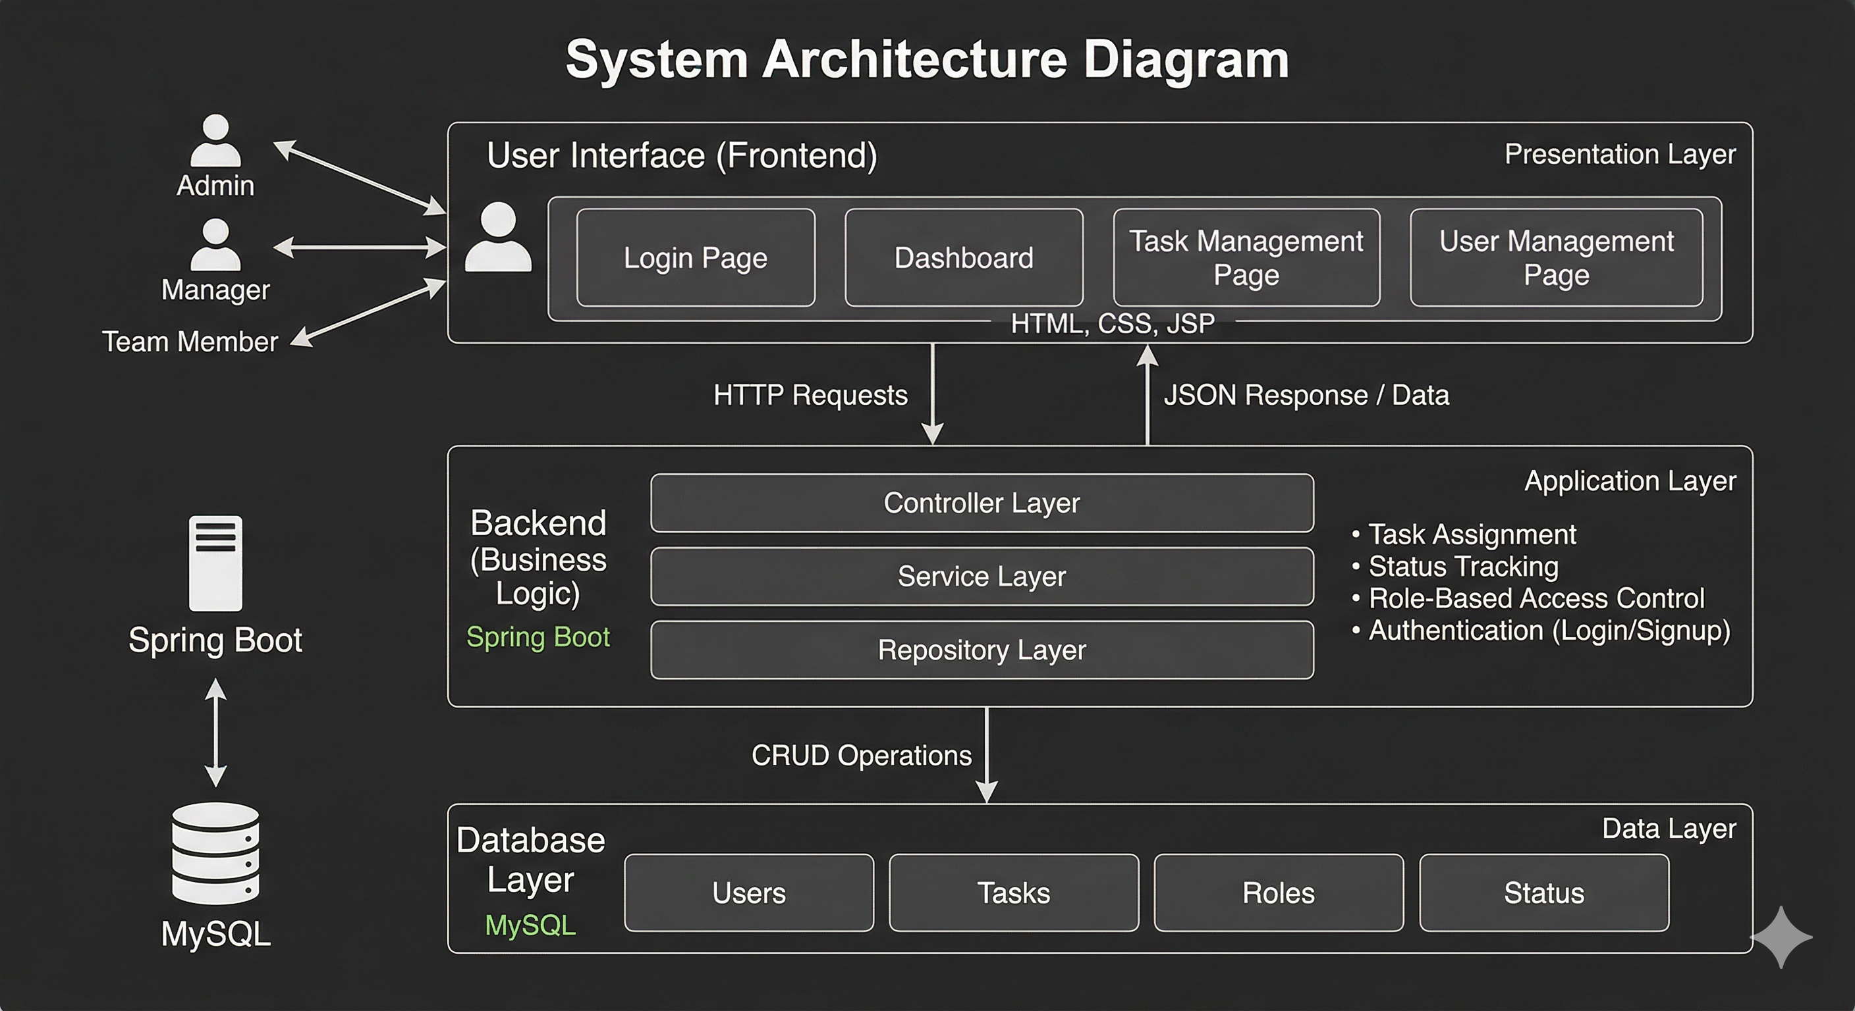
ANNA UNIVERSITY
CHENNAI
GOVERNMENT COLLEGE OF ENGINEERING, ERODE
SYSTEM ARCHITETURE
The frontend communicates with the backend through REST APIs, and the backend interacts with the MySQL database for data storage and retrieval. The system includes separate modules for users and administrators to ensure secure and efficient management.

Slide 9
ANNA UNIVERSITY
CHENNAI
GOVERNMENT COLLEGE OF ENGINEERING, ERODE
TECHNOLOGIES USED
Frontend : React.js, HTML, CSS, JavaScript, Tailwind CSS
Backend : Spring Boot, Java
Database : MySQL
APIs : RESTful APIs
Tools Used : Git & GitHub, Postman, VS Code , MySQL Workbench

Slide 10
ANNA UNIVERSITY
CHENNAI
GOVERNMENT COLLEGE OF ENGINEERING, ERODE
MODULE DESCRIPTION
User Module : User registration, login, profile management, and scheme access.
Scheme Recommendation Module : Recommends suitable welfare schemes based on user eligibility.
Application Management Module : Allows users to apply for schemes and upload required documents.
Application Tracking Module : Enables users to track application status and updates in real time.
Admin Module : Manages users, welfare schemes, applications, and verification processes.
Authentication & Security Module : Provides secure login, access control, and data protection.

Slide 11
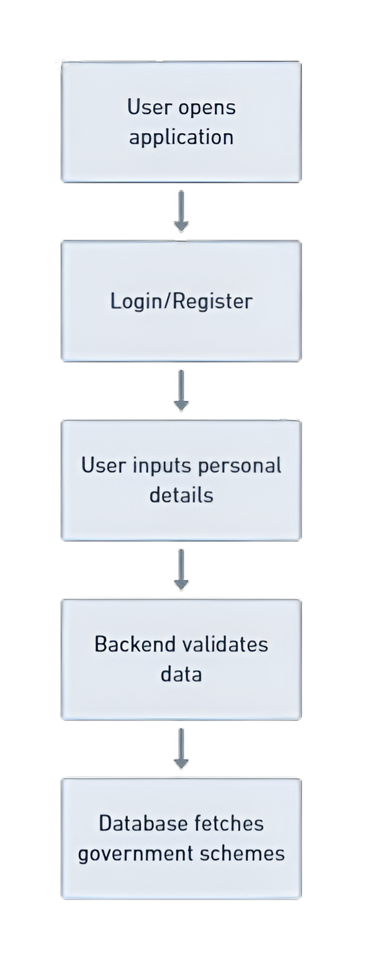
ANNA UNIVERSITY
CHENNAI
GOVERNMENT COLLEGE OF ENGINEERING, ERODE
WORKFLOW
User Registration and Login
Enter Personal and Eligibility Details
System Analyzes User Information
Suitable Welfare Schemes are Recommended
User Views Scheme Details and Applies
Required Documents are Uploaded
Admin Verifies the Application
Application Status is Updated
User Tracks Application Status in Real Time

Slide 12
ANNA UNIVERSITY
CHENNAI
GOVERNMENT COLLEGE OF ENGINEERING, ERODE
ADVANTAGES OF SYSTEM
Centralized platform for all welfare scheme information
Easy identification of eligible government schemes
Simplifies online application and document submission process
Real-time application status tracking
Reduces manual work and processing time
Increases awareness about government welfare benefits
Secure and user-friendly system for citizens and administrators

Slide 13
ANNA UNIVERSITY
CHENNAI
GOVERNMENT COLLEGE OF ENGINEERING, ERODE
CONCLUSION
The Government Welfare Advisory System successfully demonstrates how technology can be used to improve public welfare services and enhance citizen accessibility to government schemes. The project addresses major challenges in the existing system by providing a more organized, transparent, and efficient approach to welfare scheme management.
Through this system, users can easily access scheme information, reduce dependency on manual processes, and save time in searching and applying for benefits. The project also helps administrators manage applications and user data more effectively. The implementation of a centralized platform improves communication between citizens and welfare services while increasing awareness about available government support programs.

Slide 14
ANNA UNIVERSITY
CHENNAI
GOVERNMENT COLLEGE OF ENGINEERING, ERODE
REFERENCES
[1] M. Reddy, S. Rao, and V. Kumar, “Smart Beneficiary Scheme Mapping System Using Machine Learning,” International Journal of Creative Research Thoughts (IJCRT), 2025.
[2] A. Sharma, R. Kumar, and S. Patel, “GovGenius – Government Schemes Recommendation Web Application,” ResearchGate, 2024.
[3] P. Singh, A. Verma, and K. Gupta, “AI-Driven Welfare Scheme Assistance and Management System,” International Journal of Research Publication and Reviews (IJRPR), vol. 6, no. 4, pp. 1203–1208, 2025.

Slide 15
ANNA UNIVERSITY
CHENNAI
GOVERNMENT COLLEGE OF ENGINEERING, ERODE
THANK YOU !
FUTURE SCOPE
Develop a mobile application for easier access to welfare schemes anytime and anywhere.
Add notification and reminder features for application updates, deadlines, and new schemes.
Add multilingual support to improve accessibility for users from different regions.
Implement chatbot support for instant user assistance and guidance.
Integrate Aadhaar and government APIs for faster verification and automated processing.

